Slide 1
Computer Organization & Design
Computer Organization & Design
Lab 4
Substitute CPU core
-IP core design CPU/IP2CPU

Slide 2
Course Outline
Environment
Task
Principles
Implementation
Notes:
Rudimentary logic functions=基本的逻辑函数

Slide 3
Environment
Setup
1. Computer（Intel Core i5，4GB memory）
2. Spartan-3 Starter Kit Board/Sword
3. Xilinx ISE14.4

Slide 4
Course Outline
Environment
Task
Principles
Implementation
Notes:
Rudimentary logic functions=基本的逻辑函数

Slide 5
Task
1. Design CPU using IP cores and substitute CPU core in lab 3
Implement integrated CPU using given IP cores
3. Design datapath unit and do simulation：
ALU
Register Files
4. Master the usage of IP cores

Slide 6
Course Outline
Environment
Task
Principles
Implementation
Notes:
Rudimentary logic functions=基本的逻辑函数

Slide 7
Computer Organization
Decomposability of computer systems
Software
Control unit
Path: multiplexors
ALU
Registers
……
CPU
Computer System
Datapath
Hardware
Memory
Input: PS2
SW、BTN
I/O interface
Bidirectional: Storage
Output: VGA
7-Seg、LED

Slide 8
Digital circuits vs CPU organization
Digital circuit
General circuits that controls logical event with logical gates --Hardware
Computer organization
Special circuits that processes logical action with instructions -Software
Data input
Control unit
Control signals
Datapath
Data output
Status input
Status signals
Control output

Slide 9
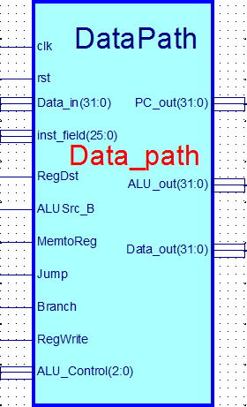
CPU part 1-datapath：Data_path
Data_path
Main part of CPU
Control target of Register transfer： general data path
Function
Calculation
General registers
General counting
Soft IP cores- Data_path
Core Module: Data_path.ngc
Interface file(empty file) ：Data_path.v
Symbol file：Data_path.sym

Slide 10
Data_path.v
module Data_path( input clk, //寄存器时钟
input rst, //寄存器复位
input[25:0]inst_field, //指令数据域
input RegDst,
input ALUSrc_B,
input MemtoReg,
input Jump,
input Branch,
input RegWrite,
input[31:0]Data_in,
input[2:0]ALU_Control,
output[31:0]ALU_out,
output[31:0]Data_out,
output[31:0]PC_out
);
endmodule

Slide 11
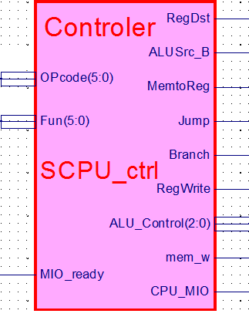
CPU part 2-controller：SCPU_ctrl
SCPU_ctrl
Main part of CPU
Arithmetic and path controller in register transfer
Function
Instruction decoder
Generate operation control signal： ALU arithmetic and logic control
Generate instruction required path
Soft IP core- SCPU_ctrl
Core module: SCPU_ctrl.ngc
Interface file(empty file) ：SCPU_ctrl.v
Symbol file：SCPU_ctrl.sym

Slide 12
SCPU_ctrl.v
module SCPU_ctrl( input[5:0]OPcode, //OPcode
input[5:0]Fun, //Function
input MIO_ready, //CPU Wait
output reg RegDst,
output reg ALUSrc_B,
output reg MemtoReg,
output reg Jump,
output reg Branch,
output reg RegWrite,
output reg mem_w,
output reg [2:0]ALU_Control,
output reg CPU_MIO
);
endmodule

Slide 13
Data path part 1：ALU
Implement 5 operations
Based on ALU in logic lab
Schematic type
simulation
ALU Control Lines | Function | note
000 | And | 兼容
001 | Or | 兼容
010 | Add | 兼容
110 | Sub | 兼容
111 | Set on less than
100 | nor | 扩展
101 | srl | 扩展
011 | xor | 扩展
Alu Operation
A
Zero
Result
Overflow
B

Slide 14
HDL code
module alu(input A, B,
input[2:0] ALU_operation,
output[31:0] res,
input zero, overflow);
wire [31:0] res_and,res_or,res_add,res_sub,res_nor,res_slt;
reg [31:0] res;
parameter one = 32'h00000001, zero_0 = 32'h00000000;
assign res_and = A&B;
assign res_or = A|B;
assign res_add = A+B;
assign res_sub = A-B;
assign res_slt =(A < B) ? one : zero_0;
always @ (A or B or ALU_operation)
case (ALU_operation)
3'b000: res=res_and;
3'b001: res=res_or;
3'b010: res=res_add;
3'b110: res=res_sub;
3'b100: res=~(A | B);
3'b111: res=res_slt;
default: res=32'hx;
endcase
assign zero = (res==0)? 1: 0;
endmodule
How do you write with overflow code ?
What is the difference The codes in the Synthesize?
always @ (*)
case (ALU_operation)
3'b000: res=A&B;
3'b001: res=A|B;
3'b010: res=A+B;
3'b110: res=A-B;
3'b100: res=~(A | B);
3'b111: res=(A < B) ? one : zero_0;
default: res=32'hx;
endcase

Slide 15
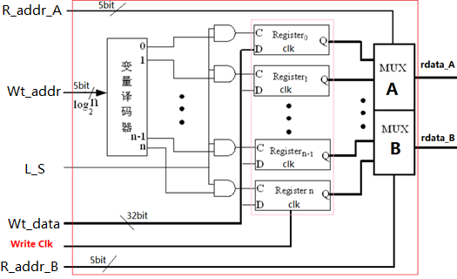
Digital system part：Register files
Implement 32×32bit register files
Optimize the Regs unit in logic lab
Use behavioral description and do simulation
Ports
Two read pins：
R_addr_A
R_addr_B
One write pin, with write signal
Wt_addr
L_S

Slide 16
Course Outline
Environment
Task
Principles
Implementation
Notes:
Rudimentary logic functions=基本的逻辑函数

Slide 17
project：OExp04-IP2CPU
Decompose CPU into two IP cores
Build CPU based on Exp03 using two IP cores
Top level is same as that of Exp03
Top_OExp04_IP2CPU.sch
Logic modules optimization
Optimize ALU module
Optimize Register Files
Objective: meet MIPS processor requirements

Slide 18
设计要点
Build CPU using IP core

Slide 19
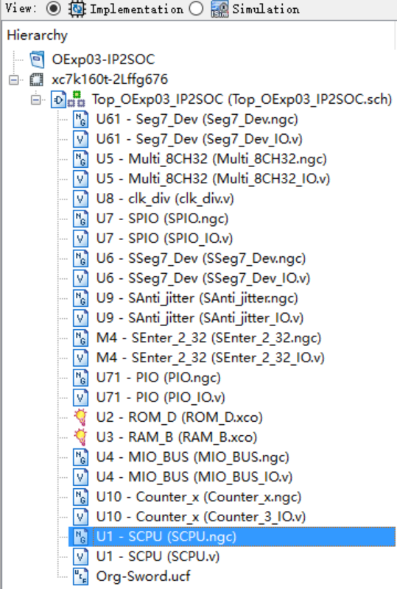
Reorganize Exp03 project
Remove CPU core in project
Delete core link
Delete core files
SCPU.ngc 和 SCPU.v
In Project menu, run: Cleanup Project Files …
Rebuild project using Exp03 resources
Remove CPU core
rename：OExp04-IP2CPU
Delete

Slide 20
Copy SCPU_ctrl.sym、Data_path.sym to current project
Copy SCPU_ctrl.ngc、Data_path.ngc to current project
Interface files: SCPU_ctrl.v、Data_path.v

Slide 21
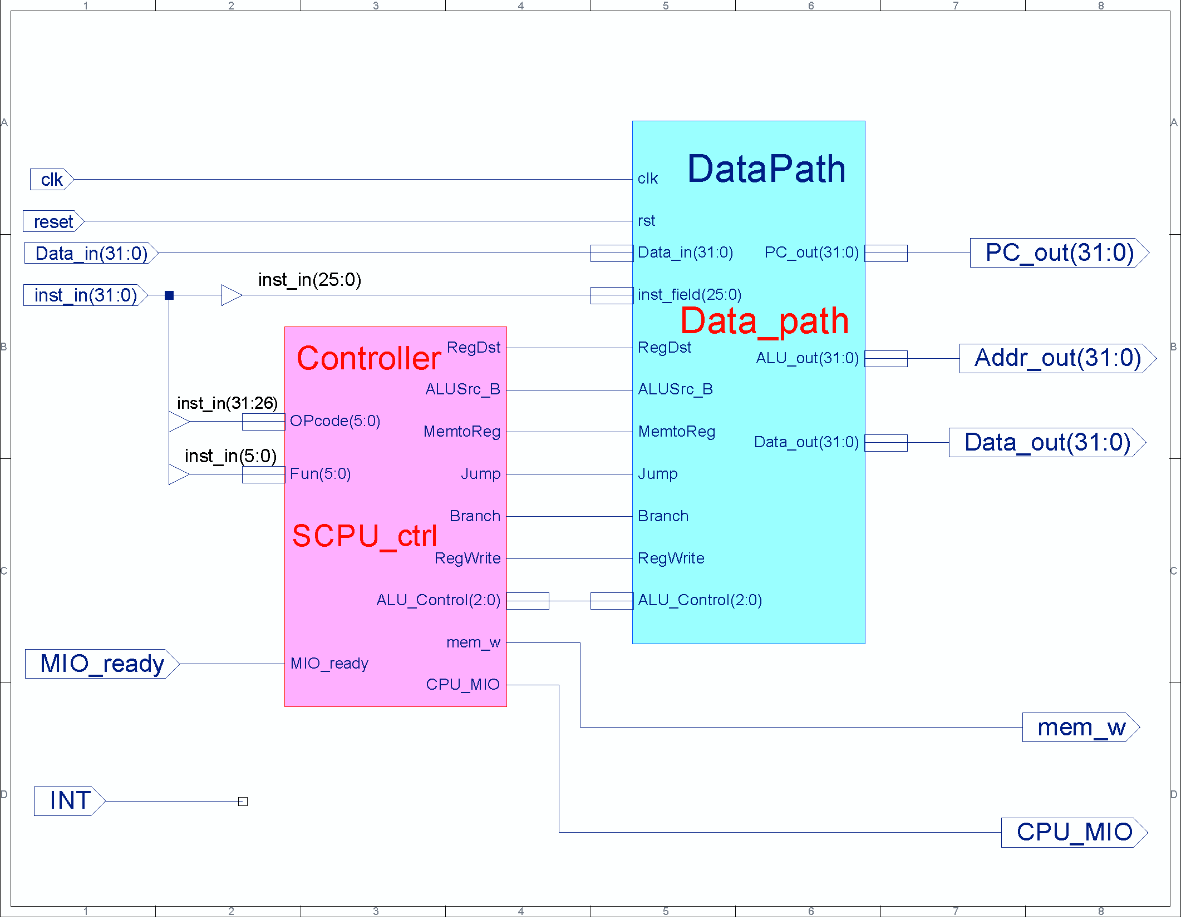
CPU design: schematic

Slide 22
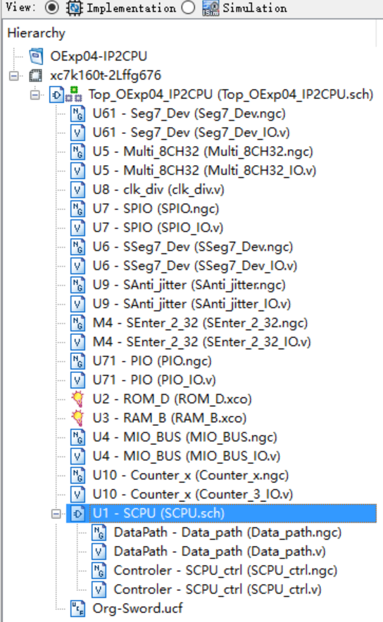
Module calling relation after CPU design

Slide 23
design ALU in schematic way
此部件是逻辑实验的ALU进一步改造供Exp05使用
为了减少相互影响请单独建立工程

Slide 24
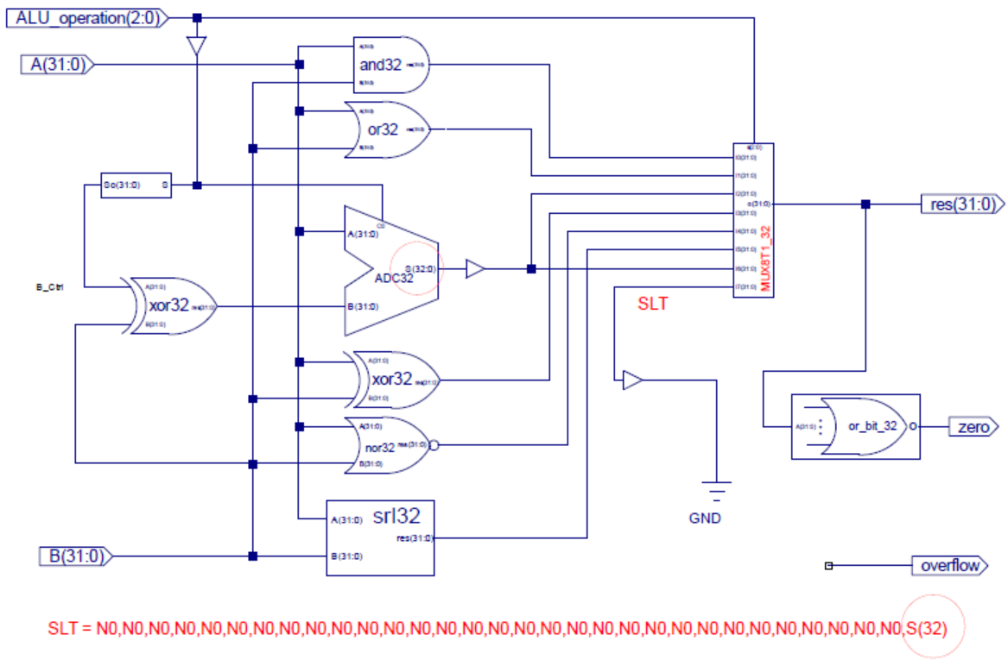
Schematic input
注意：加减器做减法时用补码是±31位
为了和无符号加法兼容需要扩展符号位
信号扩展模块
定制符号
非标准件

Slide 25
Copy the following symbol files to ALU project：
（provided in Exp01）
and32、or32、ADC32、xor32、nor32、srl32、SignalExt_32、mux8to1_32、or_bit_32

Slide 26
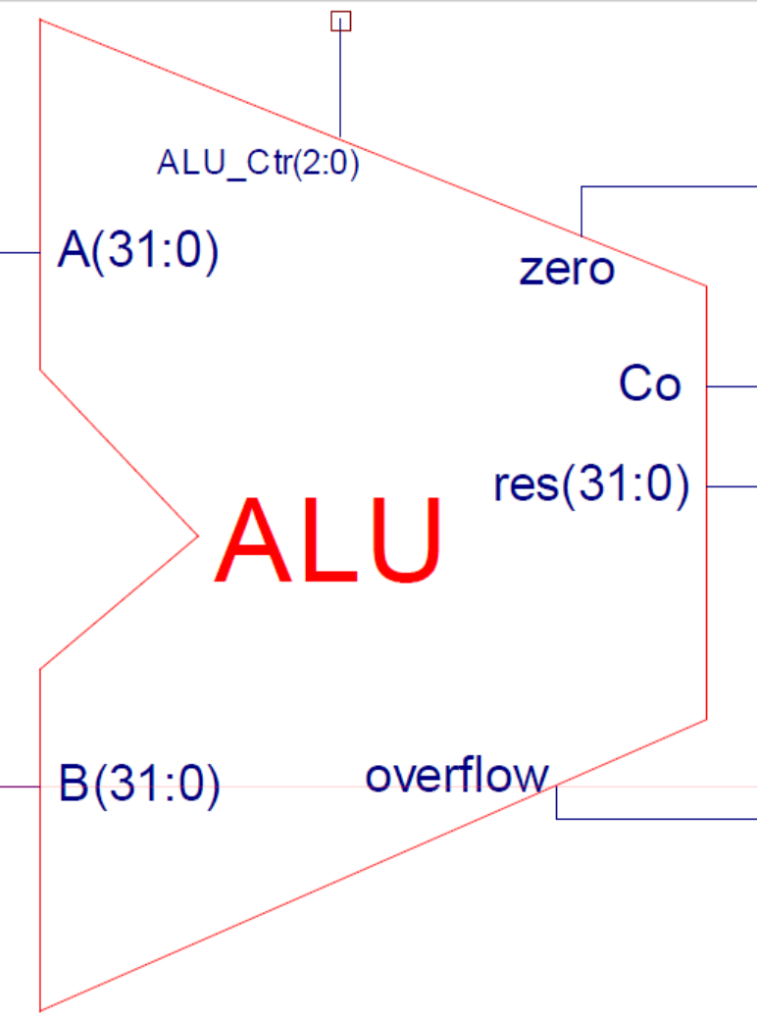
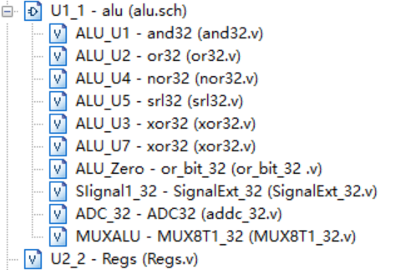
ALU simulation code
A=32'hA5A5A5A5;
B=32'h5A5A5A5A;
ALU_operation =3'b111;
#100;
ALU_operation =3'b110;
#100;
ALU_operation =3'b101;
#100;
ALU_operation =3'b100;
#100;
ALU_operation =3'b011;
#100;
ALU_operation =3'b010;
#100;
ALU_operation =3'b001;
#100;
ALU_operation =3'b000;
#100;
A=32'h01234567;
B=32'h76543210;
ALU_operation =3'b111;
仿真通过后封装逻辑符号
ALU模块调用结构

Slide 27
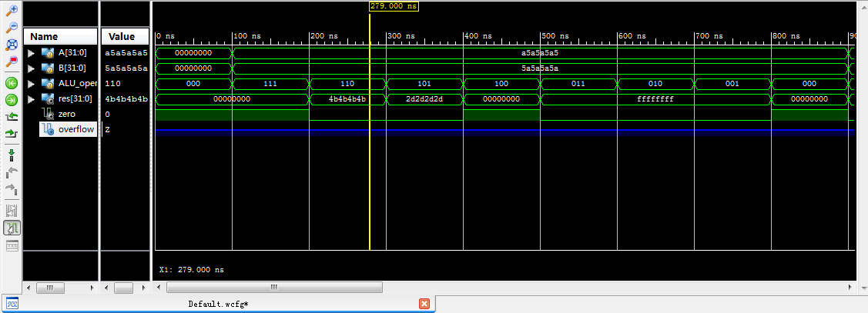
ALU_Simulation result

Slide 28
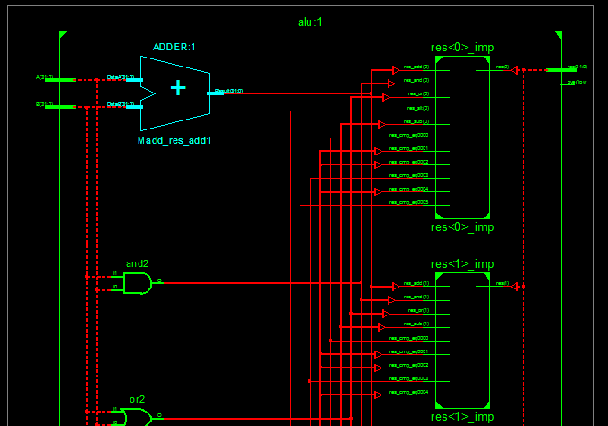
RTL-Schematic

Slide 29
Design Register files
Using Behaviral description 此部件是逻辑实验Exp10的Regs的优化供Exp05使用
可与ALU共享工程
逻辑Exp10的Regs特点：
采用逻辑门实例描述实现D触发器
采用多层调用MB_DFF触发器模块实现寄存器
采用结构描述实现Register Files

Slide 30
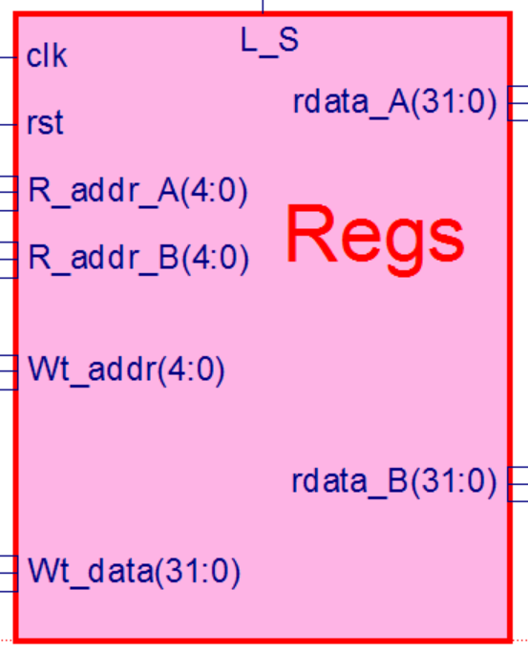
Code reference
Note that there is BUG in this code
Module regs(input clk, rst, L_S,
input [4:0] R_addr_A, R_addr_B, Wt_addr,
input [31:0] wt_data
output [31:0] rdata_A, rdata_B
);
reg [31:0] register [1:31]; // r1 - r31
integer i;
assign rdata_A = (Rs_addr_A == 0) ? 0 : register[reg_Rd_addr_A]; // read
assign rdata_B = (Rt_addr_B == 0) ? 0 : register[reg_Rt_addr_B]; // read
always @(posedge clk or posedge rst)
begin if (rst==1) for (i=1; i<32; i=i+1) register[i] <= 0; // reset
else if ((Rd_addr != 0) && (we == 1))
register[Wt_addr] <= wdata; // write
end
endmodule
仿真通过后封装逻辑符号
代码来自李亚民教授

Slide 31
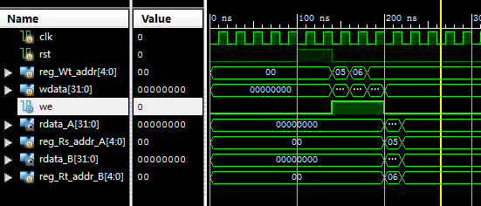
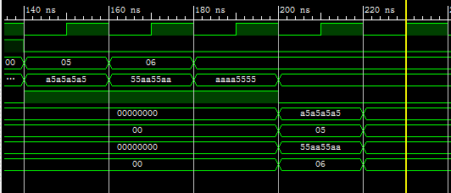
Regfile simulation

Slide 32
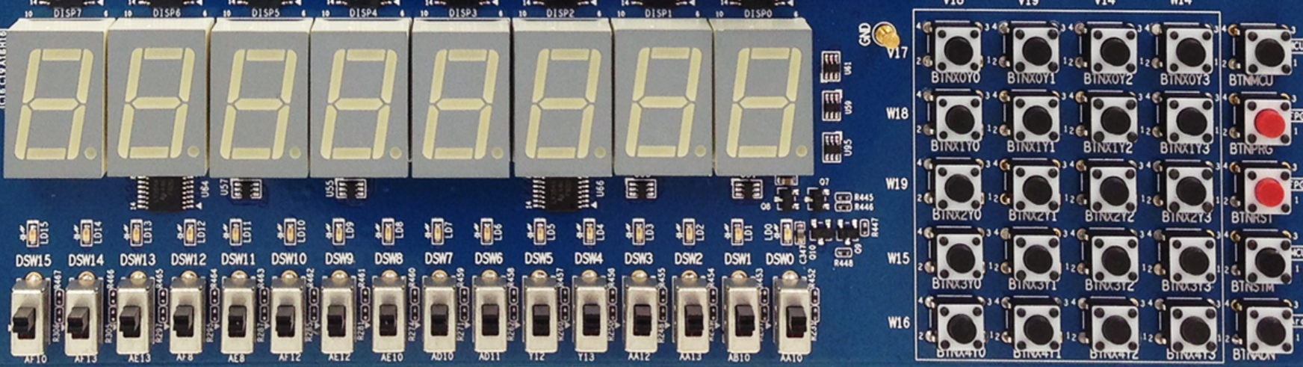
Verification-DEMO interface
Same as lab3
X₀Y₀
X₀Y₁
X₀Y₂
X₀Y₃
MCU3
0
1
2
3
X₁Y₀
X₁Y₁
X₁Y₂
X₁Y₃
PRGO
SEG3
SEG2
SEG1
SEG0
SEG3
SEG2
SEG1
SEG0
4
5
6
7
X₂Y₀
X₂Y₁
X₂Y₂
X₂Y₃
RSTN
LED15 LED14 LED13 LED12 LED11 LED10 LED9 LED8 LED7 LED6 LED5 LED4 LED3 LED2 LED1 LED0
8
9
A
B
X₃Y₀
X₃Y₁
X₃Y₂
X₃Y₃
MCU1~2
C
D
E
F
W15 SW14 SW13 SW12 SW11 SW10 SW9 SW8 SW7 SW6 SW5 SW4 SW3 SW2 SW1 SW0
X₄Y₀
X₄Y₁
X₄Y₂
X₄Y₃
Ardunio
SW[7:5]=choose datapath
SW[7:5]=000：output when CPU runs the program
SW[7:5]=001：PC word address
SW[7:5]=010：instruction word
SW[7:5]=011：counter
SW[7:5]=100：RAM address
SW[7:5]=101：CPU data output
SW[7:5]=110：CPU data input
SW[0]=text/graphics
SW[1]=upper/lower 16-bits
No use
SW[2]=CPU_clk
SW[4:3]=00，display bit-map：marquee
SW[4:3]=00，display bit-map：matrix transform
SW[4:3]=01，display memory data：0～F
SW[4:3]=10，display current reg+1

Slide 33
Thinking
How to add “overflow” function for ALU?
Hint：analyze the sign of the calculation result
Analyze Register Files design of logic Exp10
What optimization have you done in this lab？
What is the problem if we use Register Files of logic Exp10 directly?

Slide 34
END

